Slide 1

Software is eating the enterprise 10 DevOps tips to help you take control before it’s too late
Jonny Wooldridge, CTO

Slide 2






Me:
2014
CTO
Board Advisor
2011
Head of Web Engineering
2007
Director of Platform Development
2003
Lead Developer / Head of Development
1999
Web Master / Lead Java Developer
Notes:
WebMaster – that really was DevOps optimised in terms of alignment – Dev & Ops.
Hard Devops.

Slide 3
Marks & Spencer
Founded 1884, 85,000 staff
£10.3 Bn group revenues
2011-2014 introduced DevOps to international omni-channel retailer Marks & Spencer as part of a successful £150 Million retail re-platforming project. The importance of DevOps now understood at board level.
650 Member project team, 65 new or modified applications.
On time and on budget.
The control of the software delivery lifecycle via Devops principles IMHO kept the programme on the rails.
Notes:
650 Developers in multiple disparate locations – waterfall contracts. DevOps kept the project on the rails and honest.
At the time there was nowhere really to go. None of our suppliers had heard of DevOps, nobody in IT. We had to define what it meant and why it was important.
Project was iterative waterfall with outsourced and separate Development, Test, Support & Operations teams. No access to hardware. Not a particularly fertile ground for DevOps.
The In-house engineering team were at the frontier of large scale DevOps and learnt an awful lot along the way. Overcame much more than just technology challenges.

Slide 4

Cambridge Satchel
Founded 2008, 120 Staff
£10M total revenues
£100M by 2017
Now back in start-up world at Cambridge Satchel but the enterprise lessons are key to building a successful and relevant technology strategy which has longevity and agility.
$20 Million index ventures investment - clean sheet with technology online, in store, in manufacturing and in the warehouse.
Lessons learned in Enterprise DevOps applied everyday.
Notes:
Every technology decision being made is now with a backdrop of DevOps and often the 10 tips in this deck.

Slide 5
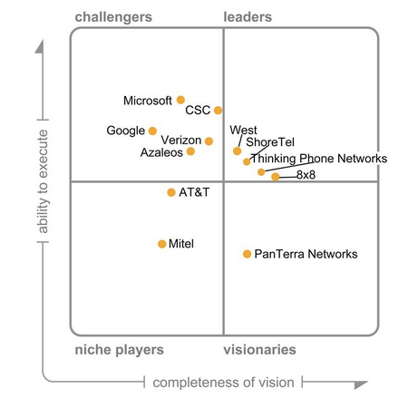
Cambridge Satchel ;-)
Cambridge
Satchel
Affordable Luxury
Everyone
else

Slide 6
Why relevant?
Lessons learned in large enterprises are absolutely relevant to anyone creating software

Slide 7
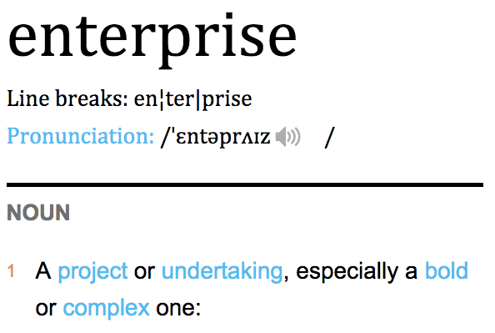

Define ‘enterprise’
Notes:
To back this up – check out the definitino from the oxford dictionary.

Slide 8
TIP #1
OVER COMMUNICATE YOUR PLAN
Notes:
Everything in my deck today I’m applying in some form within Cambridge Satchel.

Slide 9
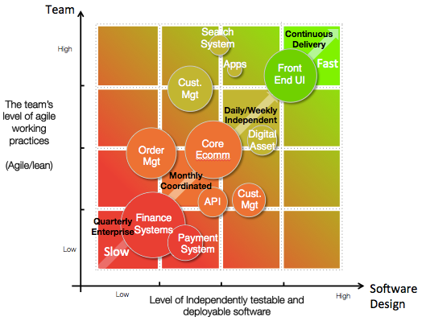
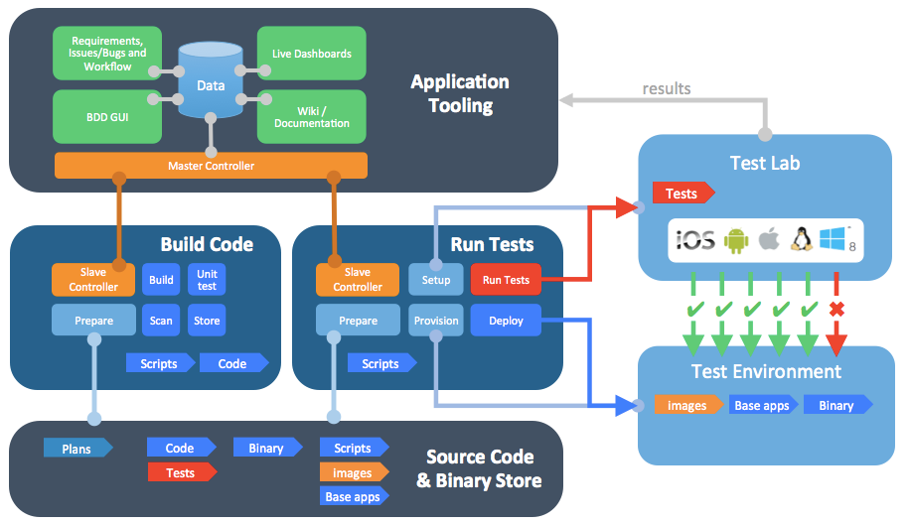
Over Communicate your plan
What are you aiming for and what value will it bring?
Paces within enterprise applications
Software Factory / Tooling
Why invest in DevOps, BDD, Automation?
A very valid question whether large enterprise or start-up
Notes:
Enterprises are backfilling years of technical debt, dysfunction and lack of control of IT processes.
Start-ups have the advantage of starting from a clean sheet.

Slide 10
Over Communicate your plan
elevator.
coffee machine.
Plan your attack and be prepared for the
Make friends across the business. You have no time for enemies. You will have to call in favours.
Keep it simple even when it’s hard. Simple metrics.
<< Show it working to bring it to life >>
Use Diagrams and keep in your back pocket.
You get noticed in an enterprise if you care. So care (a lot).
Notes:
Plan your attack: It may be boring but you need a plan. Define clear goals and explain the benefits of a DevOps approach in the enterprise. This might be required to get funding in the first place.
Keep it simple: There will be a lot of people who will not have even a basic understanding of the steps required to make great software or how team structure and ways of working are so critical. They may have had experience in the past of a bit of coding or might have some understanding of Ops but assume that they know nothing.
Show it working…: You can have all the Powerpoint presentations in the world describing your approach and the benefits it will bring but in an enterprise people won’t fully understand it until you can showcase the improvements in end to end process. Over communicate.
Use diagrams: People in the enterprise are less likely to get excited by the latest scripting platform, test automation tool or cloud service! That is until they realise what benefits it has for them or their team. Show it in pictures and compare and contrast old ways of working.
Be honest: In an enterprise this stuff is hard. Understand what you’re going after and be clear on outcomes.

Slide 11

Over Communicate your plan
and the team
“It’s all about the code”
Application code, Test code, Configuration code, Script code, infrastructure code, 3rd Party Binaries
Notes:
On the spot – define what you do.
The majority of us come to work to support the creation of code

Slide 12
Over Communicate your plan
Team
Software
Agile/Lean practices
Great Software
Good
practices
Good
Software
Poor working practices
Poor
Software
Bad working practices
Bad
Software
Notes:
From working on several initiatives within enterprises large and small it is evident that the level of DevOps maturity is driven by two factors:
The Team
Does the team have the necessary skills, working behaviours and objectives to be able to deliver small increments of software regularly. Is the team the right team?
Encompasses people and process. I can only think in 2 dimensions – a great team will have great team processes
The Software
Is the software the team is working on / inherited / designing suitable for fast delivery and has automated Build/Test/Deploy scripts?
Most large scale ecommerce platforms were built before DevOps considerations were around.
– great technology with have great processes.

Slide 13
Over Communicate your plan
$
Understand the cost to the organisation of slow releases
Excellence / Craftmanship
$$
Integration test costs
Cost of rework
$$$
Cost of delay and hand off
Cost of building the wrong thing
$$$$
Cost of not asking the right question
Notes:
From working on several initiatives within enterprises large and small it is evident that the level of DevOps maturity is driven by two factors:
The Team
Does the team have the necessary skills, working behaviours and objectives to be able to deliver small increments of software regularly. Is the team the right team?
The Software
Is the software the team is working on / inherited / designing suitable for fast delivery and has automated Build/Test/Deploy scripts?
Most large scale ecommerce platforms were built before DevOps considerations were around.

Slide 14

TIP #2
DEFINE THE PACE OF YOUR APPS

Slide 15
Define the pace of your apps.
“Let’s do DevOps” << Grass roots desire from IT
Energising
“What the..” << Middle managers
Distracting
“Why can’t we release 10x a day” << Board Directors
Scary – expectation setting required
Notes:
You can’t tak an application Ecosystem and treat it all the same. Gartner had been thinking a long the same lines with their pace layers – take a look at it.

Slide 16
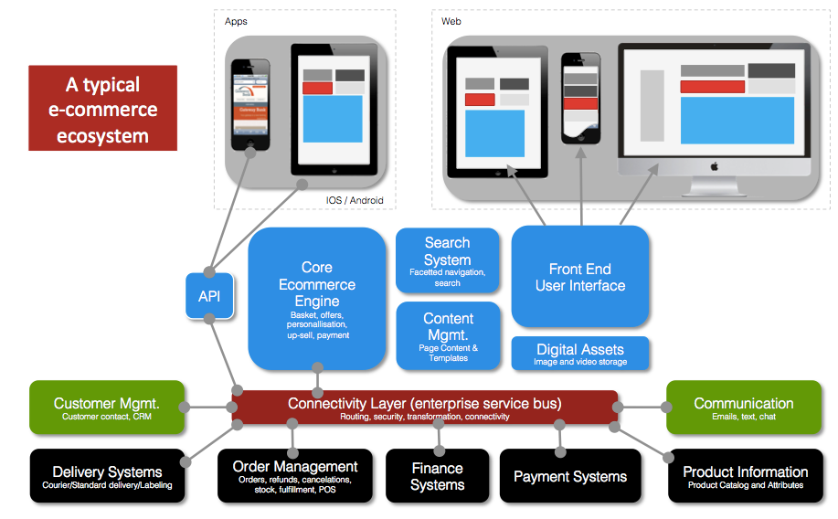
Define the pace of your applications
Notes:
Here is a typical application landscape/ecosystem for an ecommerce company with physical products – the average retailer.
I struggled when I first went from start-up world to enterprise to understand why everyone wasn’t doing Continuous Integration and working in an agile way.

Slide 17
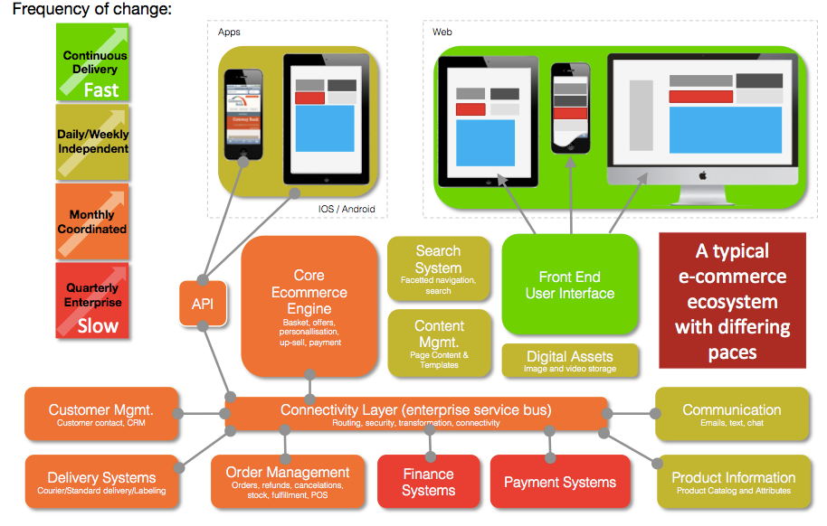
Define the pace of your applications
Pace of
Delivery
Notes:
Very colourful – apologies for that but you can see my point here. Not all applications require or can accommodate the same rate of change:
Front – end – change quickly
Payment Systems –$10s Billion going through some retailers components per year.
Different applications, different paces: Don’t assume they can all be developed, tested and deployed at the same rate of change. If you assume this you’ll never succeed with Enterprise DevOps.
Different paces, different governance: Continuously delivered applications will require different governance models to corporate releases. Treat each release type differently.
Understand your path(s) to production: Define the path to production for all your apps and the dependencies between them. This will will help you understand your roadmap and enable you to start to communicate to stakeholders expected improvements.
In a large Enterprise there will already be 10s if not 100s of applications supporting the business that have been built, bought or evolved over time.
The way in which the application is delivered, the team that deliver it and the underlying technology they are working on will affect how frequently the application can be deployed

Slide 18
Define the pace of your applications
Apps
Front End UI
Not all applications should be treated in the same way
Cust.
Mgt
API
API
API
Understand the pace layers of your apps and governance needed
API
API
API
Digital
Asset
Core
Ecomm
Order
Mgt
How good are the major vendor Ecommerce and Finance/ERP systems?
API
Finance
Systems
API
Payment
Notes:
Back to the paces – let’s put some colour (literally on this)….
Many systems are difficult to release fast due to lack of test automation coverage (of all types). Some Core Ecommerce apps sold by the major vendors are too difficult to build, test and deploy to allow for fast test cycles and frequent releases.

Slide 19
Define the pace of your applications
You want to be here!
For everything?
Apps
Front End UI
DevOps without legacy is easy.
Cust.
Mgt
Fight the right battles with your legacy
Digital
Asset
Core
Ecomm
Order
Mgt
Where you invest your $$ is critical. Invest in DevOps where it matters.
Finance
Systems
Payment
Notes:
You need to make a decision early on where you want to focus your energies.
Many legacy or corporate applications have been outsourced and might have a slow delivery cycle and governance model but this might be appropriate for the application in question.
Aim High: Aim to have continuously delivery capability for all your high priority applications.
HOWEVER, if there are reasons why you can’t or there are constraints, make sure you can continuously deliver your apps into lower environments.
Factors influencing how far you go with Continuous Delivery:
How many environments you have.
Suitability of software and the amount of automated tests.
How well you have control over the deployments made into those environments.
How many other teams are sharing the environment for their projects

Slide 20
Define the pace of your applications
Moving existing legacy apps to faster delivery is hard
Really?
Don’t make the mistake of over promising!
Legacy Zone
Trying to improve all of your applications just won’t be practical.
Notes:
As with most problems, breaking them up into small chunks makes it easier to deliver.
Focus on new applications and teams, and applications that are high risk or have a high level of business change

Slide 21

TIP #3
KILL DEPENDENCIES AT ALL COSTS

Slide 22
Kill dependencies at all cost
Components have no dependencies that require testing in a shared test environment with corporate applications
Legacy Zone
Many corporate dependencies that require testing with each other and co-ordination of data / process
Notes:
These application portfolios have multiple dependencies and the applications themselves were not designed from the outset to be decoupled from other systems.
Over time the systems have increased in technical debt and coupling.
Multimillion pounds to create new environments and setup with test data.

Slide 23
Kill dependencies at all cost
NEW
Reduce your legacy and create new capability
Reduce size and complexity of slow moving applications
Legacy Zone
E.g. consider creating a Front End separation layer enabling parts to be independently released
Notes:
Rather than try to take an existing application and continuously deploy it, those parts of the application that will need to change frequently to be independently deployable.
As an example keep the majority of the application the same but create a Front End architecture that can be ‘published’ on demand without a major release of core services.

Slide 24
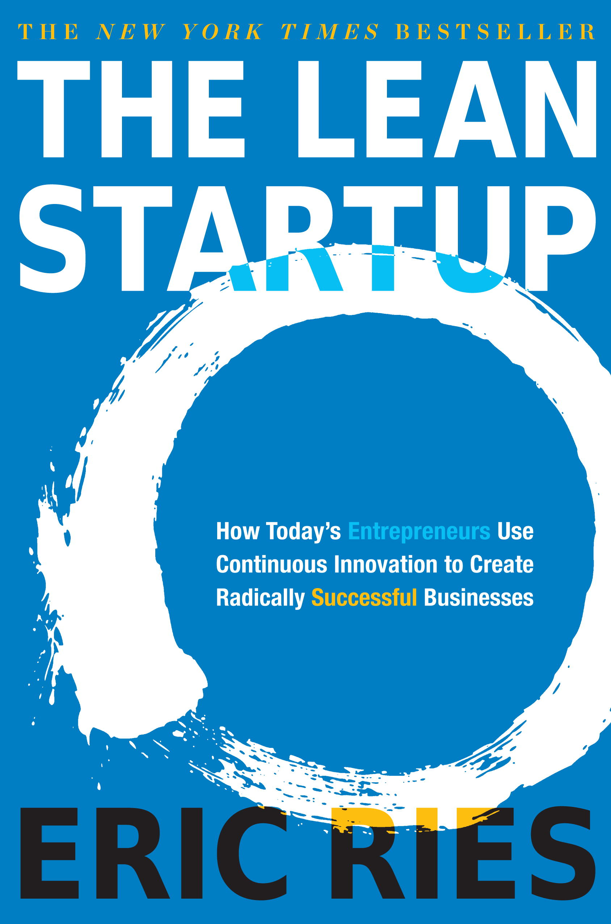
Kill dependencies at all cost
Great Book.
Everyone now wants to deploy a
‘minimum viable product’
Define ‘viable’ in an enterprise

Slide 25
Kill dependencies at all cost
Many organisations want to be lean and get value to their customers quickly
NEW
Understand what is really a viable MVP
Legacy Zone
A change considered fast is now very slow as it needs to be coordinated with a corporate release.
Notes:
Many organisations want to be lean and get value to their customers quickly.
The functionality might be ok to deliver as MVP (as signed off by the product owner), but aspects of the architecture and some enterprise dependencies actually make the chosen functionality non-viable as an MVP.
The change that was considered small and fast is now very slow (and probably expensive) as it needs to be coordinated with a corporate release.

Slide 26
Kill dependencies at all cost
Only when you have end to end visibility of speed of delivery across your ecosystem will you be able to define an MVP.
Product Owners need to understand the dependencies to prioritise.

Slide 27
Kill dependencies at all cost
Understand ALL of your dependencies: Obsessively understand and control your dependencies. It is your dependencies with other applications, particularly corporate systems that will slow you down. Try to avoid the dreaded corporate Integrated Test phase.
Decouple your applications & architecture: – create services and separate the layers of your application wherever possible.
Decouple your people: Give your teams more responsibility end to end and greater autonomy. Remove dependencies on other teams wherever possible.

Slide 28
Kill dependencies at all cost
Integrate with 3rd parties carefully. Bad choices with 3rd party integrations can kill your speed of deployment as you can become dependent on their deployment cycles, which ultimately slow your own.
Stubbing: Intelligent stubs can be a good solution but is hard and requires a strategy on ownership.
Testing is easier with less dependencies: Test scenario complexity is reduced, test data alignment is less onerous with fewer external dependencies.

Slide 29

TIP #4
DON’T CREATE NEW ‘LEGACY’
Notes:
Leave a legacy. Don’t create it.

Slide 30
Don’t create new ‘legacy’
An example project: part 1
STEP 1: Start with good intentions
In this example the team are aware of DevOps and start automating build/deploy/test and using Continuous Integration. The Operations team are involved early.
Enterprise Project Methodology/Governance/Finance promotes integrated test phases and big bang deployment. The intention is to deploy independently hence it’s position on the grid.
The plan is to think about Continuous Delivery later in the project
NEW
Legacy Zone
Notes:
. The team isn’t (yet) aware of all of their dependencies with the other enterprise applications

Slide 31
Don’t create new ‘legacy’
An example project: part 2
STEP 2: The inevitable project pressures show up
The team is under pressure and functionality is prioritised over keeping automated test and deployment scripts updated. Ops team not as engaged as they had been.
The team tried BDD but did not continue with it as the value wasn’t being seen.
Project Manager requests a detailed plan for all tasks until go-live.
Agility starts to slip. Technical debt increases.
Legacy Zone
NEW

Slide 32
Don’t create new ‘legacy’
An example project: part 3
STEP 3: Find corporate legacy dependencies
The application was on track to be delivered but new dependencies are found (e.g with corporate reporting and finance systems or corporate middleware)
The new application is now tied into a corporate release cycle.
Importantly the application might now always be tied into corporate release cycle until the dependencies are broken (if that is possible)
Legacy Zone
NEW

Slide 33
Don’t create new ‘legacy’
NEW
Set the bar high for new initiatives / programmes
When a new initiative comes along and a new team is built to deliver it set the bar high with DevOps operational requirements and ways of working.
Encompass:
Behaviour Driven Development
Continuous Integration
Continuous Delivery
Full automation
Robust configuration management
Legacy Zone
Notes:
How many people have new projects that you’ll be undertaking. Raise the bar high, do things differently. You have the advantage of widespread understanding and proof that DevOps makes a difference. What’s stopping you doing the right thing on greenfield projects?

Slide 34
Don’t create new ‘legacy’
Ensure your corporate project methodology encourages DevOps..
…else you’ll create legacy every time
Legacy Zone
NEW
How do you measure success of your projects?
Notes:
It is often the case that a company’s project funding model and associated gated project methodology focuses too heavily on delivery of a project on time and budget.
The operational requirements of scripted build, deployment, testing, validation are often considered too late in the project lifecycle (once vendors and technology are chosen).

Slide 35
Don’t create new ‘legacy’
<< Make end-to-end process a deliverable >>: You need to find a way to ensure that the full end to end process of delivering software is part of the project. If it is not the teams will lose focus and potentially slip into traditional ways of working that are more familiar.
Product Teams vs Project Teams: Product teams are far more likely to want the end-to-end process to be fast, for the software to have low levels of technical debt and be easily supportable.
Legacy ≠ old: Many teams, and perhaps the majority in an Enterprise (even those using agile methods) are set up to deliver legacy. It might be functionally rich and value creating legacy, but it will be difficult to move into continuous delivery.
Coaching and Mentors: It is crucial that help is on hand to show the teams what good looks like and to keep them on track both from a team point of view and technology

Slide 36

TIP #5
DEVOPS IS NOT JUST AN IT PROBLEM

Slide 37
DevOps is not just an IT problem
Project Methodology. A gated Waterfall based project methodology will lead to a focus on dates not necessarily value creation and customer satisfaction.
HR, recruitment and rewards - in the same way that Agile was disruptive, DevOps is even more so as it affects the wider team and end-to-end processes. Often organisational structures at a high level, and the bonus and rewards received encourage silo thinking.
Finance & Procurement – funding allocation and total cost of ownership. A better built app today is worth the investment but may not get funding. Tool purchases can stall waiting on the procurement process.
Notes:
Some of the large vendor commerce platforms weren’t designedwith rapid deploys in mind.

Slide 38
DevOps is not just an IT Problem
Wrong team objectives & rewards
Enterprise equilibrium tends to push your DevOps adoption backwards
Wrong 3rd Party Suppliers
Wrong hiring policy
Wrong contractual & financial frameworks
Make the wrong choice and the forces may be working against your goal of faster delivery.
Wrong technology choice
Notes:
Hosting partners – no access to code.
The reason being, the technology and staffing choices you make now will affect how you can scale in the afuture.
Choices that in the past might have been judged on a single project delivery are now judged on capability to deliver incrementally ongoing.

Slide 39

TIP #6
You are unique. Think for yourself

Slide 40

You are unique. Think for yourself
A shared DevOps capabilty can speed-up other team’s DevOps adoption
A shared capability to assist environment creation and tool setup
Shared
Tooling
Automation
Oil the enterprise machine by removing common impediments
Cloud
Adoption
Ways of
Working
Notes:
Most blogs and writing on DevOps makes the point that a DevOps team is an anti-pattern.
I just ignored that because I could see that in an enterprise it makes sense. Even in a start=up it could make sense.
In a start-up, or where the challenge is isolated to a few teams then this is correct.

Slide 41
You are unique. Think for yourself
?
?
?
✔
You’re going to have to think for yourself.
There are still a lot of areas of enterprise DevOps that still need to be answered
Keep an open mind and innovate yourself
Notes:
Not an anti-pattern in my view, but happy to discuss afterwards
Bigger questions exist the deeper into legacy world you go
Things that have worked for one company may not work fully in another company due to all the different factors at play.

Slide 42

TIP #7
MAKE YOUR TOOLS WORK FOR YOU

Slide 43
Make your tools work for you
Expensive Tooling won’t move the needle on its own
Wrapping entire legacy applications in new automation deployment software isn’t the answer.
$$$
Legacy Zone
Don’t automate your legacy processes!
Notes:
For example it won’t increase your level of automated test coverage or help you with your architectural dependencies

Slide 44
Make your tools work for you
MULTIPLE DIGITAL
TOOLSETS
New Ways of working dictate new flexible connected tooling
Embrace best of breed Open Source and make sure you don’t get tied to a particular tool..
Multiple sets of tools need to co-exist
TRADITIONAL
TOOLSET
..specifically don’t be tied to your corporate toolset
Notes:
New ways of working require different toolinzg that most likely is new in your organisation

Slide 45
Make your tools work for you
<<New Digital Toolset >>: Create a decoupled toolset of best of breed tools. You don’t need the same tools for all paces.
Don’t be held back by corporate toolset: Corporate tools generally don’t cut it
Make your tools work for you: Don’t change the way you work because you have a new tool. Make sure the tool works for you not the other way around.
Embrace OpenSource where possible: but don’t rule out paid for products if it makes sense.
Notes:
Had a one-on-one session with VP of product for large ALM vendor a couple of years ago – I wanted Multi-pace multi vendor propogation of builds, test, deploys in various integration environments to work in their toolset. Answer: You’ll have to wait 3 years for that…..
Another large Vendor rebrand all of their products ‘DevOps’ – ie a single aligned view of software engineering, yet they have silos in their own sales team. Would need to talk to 4 different people to get the end-to-end view.
Fight the ‘This is the corporate standard’ anti-pattern.
The corporate standard tools did not join up the DevOps journey.
Free the team to innovate – locked down environments stifling innovation. Teams on the phone repeating commands down the phone – skype was banned by the way at the time.

Slide 46

TIP #8
BUILD A SOFTWARE FACTORY

Slide 47

Build a Software Factory
You wouldn’t manufacture any other product at scale with ad-hoc methods and so little visibility and traceability

Slide 48
Build a Software Factory for control and visibility
Build a software factory, why?
Let developers focus on creativity – the creative aspects of writing code, not how their code gets into environments for testing
Connect your tooling to get value and increase visibility. Network affect.
Don’t forget information security! Add them into your build pipeline.
Get visibility of everything – visibility of every code commit, every requirement, bug and release. Auditors will love you!

Slide 49





Build a Software Factory
Requirements, Issues/Bugs and Workflow
Live Dashboards
Data
Application
Tooling
results
BDD GUI
Wiki / Documentation
Master Controller
Test Lab
Tests
Build Code
Run Tests
Slave
Controller
Build
Unit test
Slave
Controller
Setup
Run Tests
Prepare
Scan
Store
Prepare
Provision
Deploy
✔
✔
✔
✔
✔
✖
Test Environment
images
Base apps
Binary
Plans
Code
Binary
Scripts
Source Code
& Binary Store
Tests
images
Base apps
©

Slide 50
Build a Software Factory
Fully Integrated tools:
Requirements, Issues/Bugs and Workflow
Live Dashboards
Requirements/Wiki
Source Code Mgt.
Binary Store
Code check-in/build
Code Quality scan
Environment Mgt.
Deployment
Test
Log Storage
Data
Application
Tooling
BDD GUI
Wiki / Documentation
Master Controller
Plans
Code
Binary
Scripts
Source Code
& Binary Store
Tests
images
Base apps
©
Notes:
Link Best of Breed Tooling together
This is relevant to all technology including Saas platforms – Demandware.

Slide 51
Build a Software Factory
Fully Integrated tools:
Requirements, Issues/Bugs and Workflow
Live Dashboards
Requirements/Wiki
Source Code Mgt.
Binary Store
Code check-in/build
Code Quality scan
Environment Mgt.
Deployment
Test
Log Storage
Data
Application
Tooling
BDD GUI
Wiki / Documentation
Master Controller
Plans
Code
Binary
Scripts
Source Code
& Binary Store
Tests
images
Base apps
©

Slide 52
Build a Software Factory
Requirements, Issues/Bugs and Workflow
Live Dashboards
Data
Application
Tooling
Fully Integrated tools:
BDD GUI
Wiki / Documentation
Requirements/Wiki
Source Code Mgt.
Binary Store
Code check-in/build
Code Quality scan
Environment Mgt.
Deployment
Test
Log Storage
results
Master Controller
Build Code
Slave
Controller
Build
Unit test
Prepare
Scan
Store
Plans
Code
Binary
Scripts
Source Code
& Binary Store
Tests
images
Base apps
©

Slide 53
Build a Software Factory
Requirements, Issues/Bugs and Workflow
Live Dashboards
Data
Application
Tooling
results
BDD GUI
Wiki / Documentation
Master Controller
Test Lab
Tests
Build Code
Run Tests
Slave
Controller
Build
Unit test
Slave
Controller
Setup
Run Tests
Prepare
Scan
Store
Prepare
Provision
Deploy
✔
✔
✔
✔
✔
✖
Test Environment
images
Base apps
Binary
Plans
Code
Binary
Scripts
Source Code
& Binary Store
Tests
images
Base apps
©

Slide 54
Build a Software Factory
Requirements, Issues/Bugs and Workflow
Live Dashboards
Data
Application
Tooling
BDD GUI
Wiki / Documentation
Master Controller
Test Lab
Tests
Build Code
Run Tests
Slave
Controller
Build
Unit test
Slave
Controller
Setup
Run Tests
Prepare
Scan
Store
Prepare
Provision
Deploy
Test Environment
images
Base apps
Binary
Plans
Code
Binary
Scripts
Source Code
& Binary Store
Tests
images
Base apps
©

Slide 55
Build a Software Factory
Requirements, Issues/Bugs and Workflow
Live Dashboards
Data
Application
Tooling
BDD GUI
Wiki / Documentation
Master Controller
Plans
Code
Binary
Scripts
Source Code
& Binary Store
Tests
images
Base apps
©

Slide 56
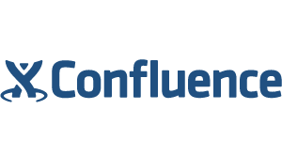















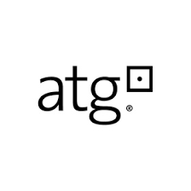



Build a Software Factory
Application Tooling
Test Lab
Build Code
Provision env & Run Tests
✔
✔
✔
✔
✔
✖
Test Environment
Source Code
& Binary Store
©
Notes:
Not a single one of these systems existed

Slide 57
Build a Software Factory for control and visibility
Have insight into your offshore suppliers like never before
Have control of your offshore suppliers like never before
Software Delivery data and information in one place

Slide 58
MAKE YOUR PARTNERS USE YOUR FACTORY
Control the deliverables from your partners
Do you really understand who is working for you?
Do you know the quality of the development?
Maintain ownership of your delivery pipeline at all costs
Force all suppliers through your delivery pipe without exception
Builds are created from your code repository and all 3rd Pary binaries versioned and centrally stored.
Again, if you show you care, your partners will care.
Notes:
Outsource your development, but keep the teams honest by making everybody come through your factory Machines.

Slide 59
TIP #9
START BEHAVIOUR DRIVEN DEVELOPMENT TODAY

Slide 60
Start Behaviour Driven Development Today
Absolute Game Changer in all companies I’ve introduced it
BDD is more than TDD as it engages the business – usually the business switch off when talking tests
Keeps DevOps on track – forces the right kind of automation
Keeps artifact aligned with Code (Test code, Config, Test Data)
If you do nothing else today – read up on BDD.

Slide 61

TIP #10
PREPARE TO BE THE LARGE ENTERPRISE OF TOMORROW

Slide 62

Prepare to be the large Enterprise of tomorrow
..so as discussed earlier make the right choices today with:
Technology
Hiring, Retention & Training
Contracts & Procurement
3rd Party Suppliers and Vendors.
Make the correct choices to keep on the correct DevOps trajectory
Notes:
3 year

Slide 63
Cambridge Satchel
We will be here!
Apps
Focus on systems that will be key to innovation
Front End UI
Cust.
Mgt
25% Custom, 75% SaaS
SaaS solutions where possible for back office
Digital
Asset
Core
Ecomm
Order
Mgt
Strategy to stay on high alert for creation of any new dependencies or Silos
Finance
Systems
Payment
Notes:
You need to make a decision early on where you want to focus your energies.
Many legacy or corporate applications have been outsourced and might have a slow delivery cycle and governance model but this might be appropriate for the application in question.
Aim High: Aim to have continuously delivery capability for all your high priority applications.
HOWEVER, if there are reasons why you can’t or there are constraints, make sure you can continuously deliver your apps into lower environments.
Factors influencing how far you go with Continuous Delivery:
How many environments you have.
Suitability of software and the amount of automated tests.
How well you have control over the deployments made into those environments.
How many other teams are sharing the environment for their projects

Slide 64
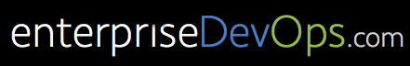
Thank you
Thanks for listening!
Jonny.wooldridge@cambridgesatchel.com
My blog, these slides and other musings available at:
www.enterprisedevops.com / www.enterprisedevops.io

Slide 65

HERE’S WHAT I’D LIKE HELP ON

Slide 66
Here’s what I would like help on
If you’ve got the answers to any of these I’d love to hear from you:
managing test data in complex environments where systems need aligned data
Ensuring your Behaviour Driven Development scripts (e.g. gherkin files) can be easily version managed across multiple branches of code.
Out of the box DevOps Factories?
Notes:
3 year

